Slide 1
DEFINITION OF TERMS

Slide 2
SPECIAL EDUCATION/ SPECIAL NEEDS EDUCATION
The practice of educating students in a way that provides accommodations/ support that address individual differences, disabilities/ special educational needs

Slide 3
Special Educational Needs
Challenges/ obstacles / challenges that make it hard for a child to learn
E.g. learning difficulties, disabilities, behavioral difficulties, social disabilities etc

Slide 4
disability
A result of an impairment that can be physical, sensory, cognitive, emotional or a combination of these that limits a person’s ability to do certain tasks/ participate in typical daily activities

Slide 5
handicap
Any disadvantage/ factor which makes it hard for a person with disability to preform certain tasks.
Can result from a disability/ society’s attitudes towards disability

Slide 6
impairment
Loss/ damage of any body part/ organ that leads to deterioration in functioning/ reduction in functioning

Slide 7
Accomodation
An alteration of environment , curriculum or equipment that allow a person with disability / SEN to gain access to content/ complete tasks

Slide 8
Modification
A change in the curriculum for students who are unable to understand all the content that an instructor is teaching

Slide 9
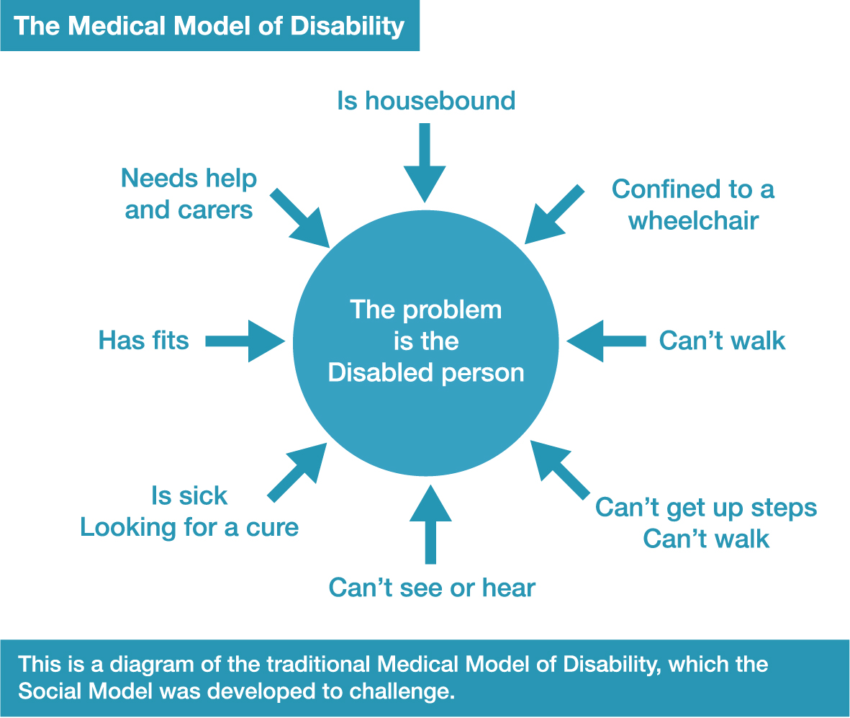
Understanding disability
Disability is a problem that can be corrected/ cured
The problem is with the affected person
If not cured/fixed= never be equal to his peers

Slide 10
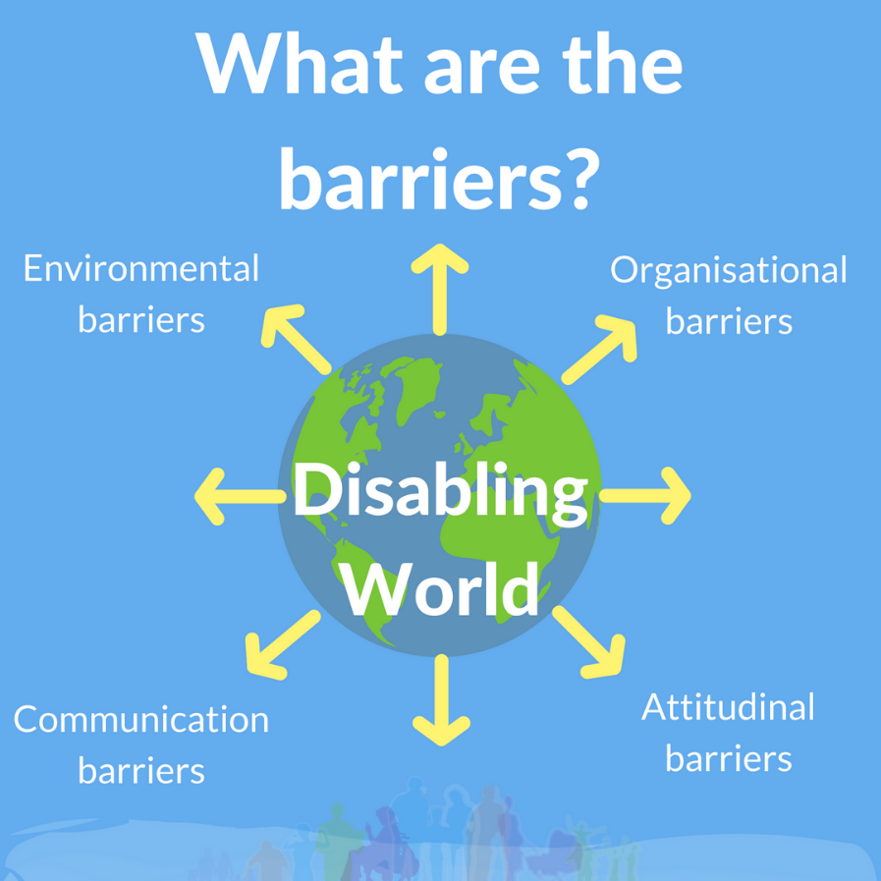
Challenges are due to the environment not impairments
Barrier can be physical/ attitudes

Slide 11
Inclusive education
All students regardless of any challenge they may have are placed in age appropriate general education classes that are in their own neighborhood schools to receive instruction, interventions, support that enable them to meet success in core curriculum

Slide 12
Activity : Indicate whether the type of children listed below fall under those with disabilities or SEN
Children who have problem with hearing
Those who have bad handwriting
Children who have problem with vision
Those who fail to understand mathematical concepts
Those who have unstable emotions

Slide 13
Activity conti…….
Those with very bad handwriting
Those who have bad behavior
Those with depression
Those who have mental illness
Those with chronic diseases
Those who have low IQ
Genius learners

